Slide 1
THE PERSONNEL STRENGTH AND THE STAFF TO STUDENTS RATIO IN THE UNIVERSITY: CHALLENGES AND WAY FORWARD
BY
MR. ADEOYA BABAJIDE ADESOLA
Director Of Personnel
Being A Paper Presented At The Academic Summit Of The Ekiti State University on Wednesday 3rd February, 2016

Slide 2
INTRODUCTION
History has not been kind to reveal the actual background that led to the agitation of the Establishment of the University in 1982. Mind you, Ekiti produced the first graduate in 1897 and this can be verified again, Ekiti produced a large chunk of graduates as from 1946 and as far back early 1950’s most communities added more in trickles. According to Late Chief Akintola “Ekiti nkawe”

Slide 3
BRIEF HISTORY
The University was established in March 1982. The information about the University is highlighted below and it has been overflopped.
Former names: Obafemi Awolowo University (1982), Ondo State University(1985), University of Ado-Ekiti (1999), Ekiti State University, Ado Ekiti (2011)
Type:State-owned University
Established: 1982
Chairman: Prince DayoAdeyeye
Vice-Chancellor: Professor Samuel Oye Bandele
Students: 25,000
Undergraduates: 23,000
Postgraduates: 2,000
Location: Ado-Ekiti, Ekiti State
Website: www.unad.edu.ng, www.eksu.edu.ng

Slide 4
Key Concepts and definition of terms
Personnel Strength
Staff Student Ratio
The way forward

Slide 5
Personnel
Personnel are the people who work for a particular company or organization. In this context, those who are legitimate workers of the University and are being paid by the University on a regular basis whose appointment are regular and who are sure of promotion, confirmation or renewal of contract appointment and who can face disciplinary action of such an institution. People who work for it.

Slide 6
Personnel Strength
Here it will not be out of place to explain in a single term that the activities of personnel can be summarized as indicated below
Administrative discipline of hiring and developing employees so that they become more valuable to the organization. It includes
conducting job analyses,
planning personnel needs, and recruitment,
selecting the right people for the job,
orienting and training,
determining and managing wages and salaries,
providing benefits and incentives,
appraising performance,
resolving disputes,
communicating with all employees at all levels.

Slide 7
STAFF TO STUDENT RATIO
S/N | FACULTY | TEACHER STUDENT RATIO
1. | ADMIN/MANAGEMENT SCIENCES | 1:30
2. | ARTS/HUMANITIES | 1:30
3. | SOCIAL SCIENCES | 1:30
4. | LAW | 1:30
5. | EDUCATION | 1:30
6. | SCIENCES | 1:20
7. | AGRICULTURAL SCIENCE | 1:15
8. | ENGINEERING | 1:15
9. | MEDICINE | 1:10
Table 1: The teacher Student ratio as approved by the NUC is as follows:
Source: From NUC

Slide 8
STAFF TO STUDENT RATIO
S/N | FACULTY | TEACHER STUDENT RATIO
1. | SCIENCE BASED | 1:4
2. | ARTS BASED | 1:20
Table 2: Teaching to Non-Teaching staff ratio
Source: From NUC

Slide 9
CHALLENGES AND THE WAY FORWARD
“I recall in Senate, when the report of a Professor who had just returned from sabbatical was read on the floor of Senate. The report affirmed that our returnee Professor was the best lecturer at the University of Benin. What criteria were used, and can we adopt it? Then, we need orientation to rebrand our lecturers and other members of staff.”

Slide 10
1. Is there any relevance and after effect as a result of change of name of the University from University of Ado-Ekiti to Ekiti State University?
UNIVERSITY NAME | ACADEMIC SESSION | No. Matriculated
University of Ado-Ekiti | 2002/2003 (cut-off @ 200 and One O’level result | 3,158
 | 2004/2005 | 8,694
 | 2005/2006 | 3,790
 | 2006/2007 | 3,948
 | 2007/2008 | 4,693
 | 2008/2009 | 4,534
 | 2009/2010 | 2,981
 | 2010/2011 | 2,646
Ekiti State University | 2011/2012 | 3,982
 | 2012/2013 | 3,836
 | 2013/2014 | 1,931
 | 2014/2015 (cut-off at 180 and Two O’Level Sittings) | 4,408
Table 3: Matriculation List from 2002/2003 – 2014/2015
Source: From Senate and Academic Matters (2016/2)

Slide 11
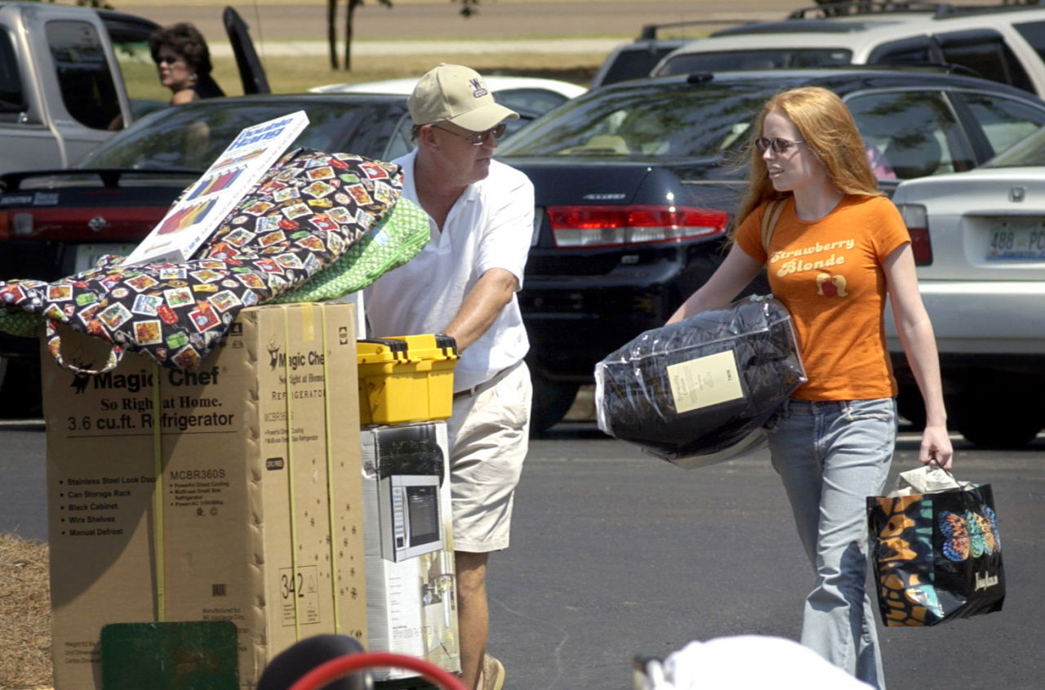
ii. Why are parents running away from sending their wards to this University?

Slide 12
iii. Why are admissions seekers not patronizing our programmes?
S/N | University | No. of Applicants
1. | University of Ilorin | 85,495
2. | University of Benin | 60,020
3. | Nnamdi Azikwe University | 58,410
4. | Ahmadu Bello University | 52,785
5. | University of Lagos | 49,059
6. | Ekiti State University | 4,292
Table 4: JAMB 2015 Applicants in selected Universities
Source: From JAMB Website

Slide 13

iv. Why are members of staff, particularly, Teaching staff sending their wards to Private Universities?

Slide 14
v. Are products of Private Universities better than Federal/State Universities?
Faculties | Faculty Screening | Central Screening
Agricultural Sciences | 275 | 42
Arts | 507 | 170
Education | 133 | 114
Engineering | 98 | 81
Management Sciences | 773 | 211
Sciences | 1200 | 240
Social Sciences | 661 | 224
Law | 86 | 4
Total | 3458 | 1086
Table 5: Screening of Newly Admitted students
Source: From Senate and Academic Matters (2016/2)

Slide 15
Please note that Ahmadu Bello University, Zaria matriculated about 11,049 students while University of Ilorin matriculated only 10,400 students last week. From the foregoing, it should be observed that the Culture of the University has to change and the following are observed as some of the reasons why the University is not in hot demand by prospective candidates seeking admission:

Slide 16
Most parents are not happy that results of their Children/Wards are not released on time and therefore they inform their friends who also frown at this prolonged delay and are therefore discouraged.
The Non-Teaching Staff, Administrative and Bursary staffs were also accused of not attending to students promptly. Rumour has it that some Members of Staff (Teaching and Non-Teaching) say negative words into the life of the Students which are not palatable for them and their parent when informed. This projects the University in a bad light.
There is a report of high rate of failure in some Faculties. Management should look inwards and the policy makers i.e. Academicians in Administration should monitor the activities of their staff.

Slide 17
A NEW EKITI STATE UNIVERSITY: A NEW ERA
There is no gain saying to remind ourselves that, the welfare, the interest and progress of our Students and their upward mobility should be our joy and aspiration. It is because we have Students that we have Staffers. Arising from the above, the following are suggested as a way forward.

Slide 18
A NEW EKITI STATE UNIVERSITY: A NEW ERA
The entire workforce in the University requires a new orientation of having a staff to have a positive attitude towards Students.
All members of Staff should see Students as their Children and hence encourage them to be alive to their responsibilities.
Students should be protected, supported, encouraged, counselled and motivated positively.
We should stop threatening Students that they won’t pass or that they will repeat courses.
Lecturer should know that if majority of those they teach fail, then they have not impacted knowledge.

Slide 19
A NEW EKITI STATE UNIVERSITY: A NEW ERA
Prompt release of Students’ examination results after due consideration by the Departmental Board on Semester basis and erring Department should be sanctioned.
Staff Advisers should be made to be friendly to Students and give proper guidance on courses to offer.
More classrooms for lectures must be put in place.
Campus beautification to arouse student interest.
Sports facilities should be improved upon.

Slide 20

THANKS FOR LISTENING

